Slide 1
PhD Interview talk

Slide 2
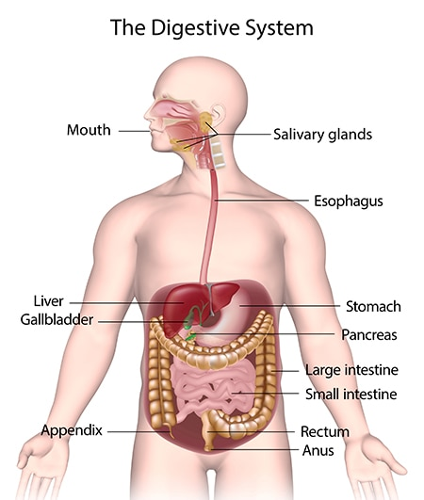
https://www.niddk.nih.gov/health-information/digestive-diseases

Slide 3
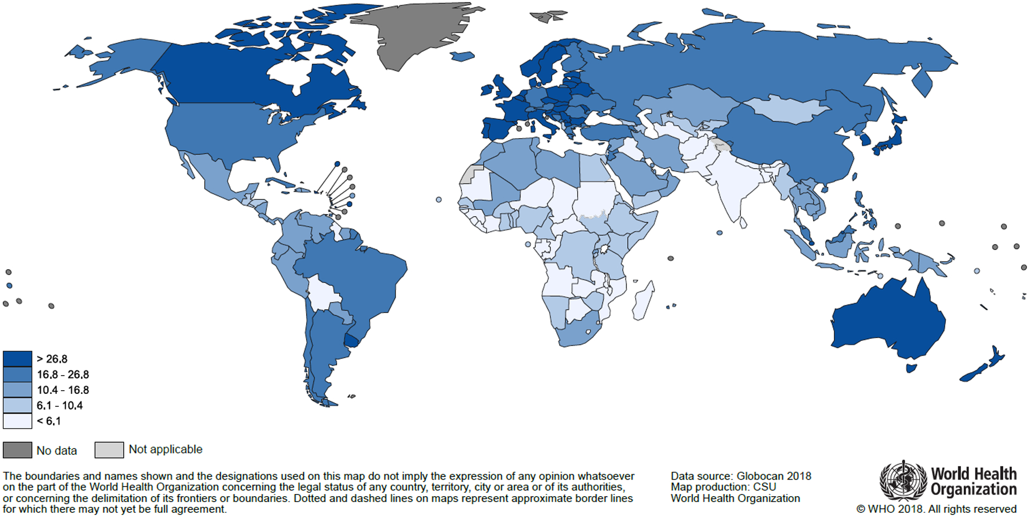

Slide 4
”Interesting data comes from study conducted that in 2007 to 2016, 2006 to 2015 or 2005 to 2014, depending on the data’s availability, colon cancer incidence increased in 10 of 36 countries analyzed (all in Asia or Europe); India had the most significant increase, followed by Poland.”
Arnold M., et al. Global patterns and trends in colorectal cancer incidence and mortality. Gut

Slide 5
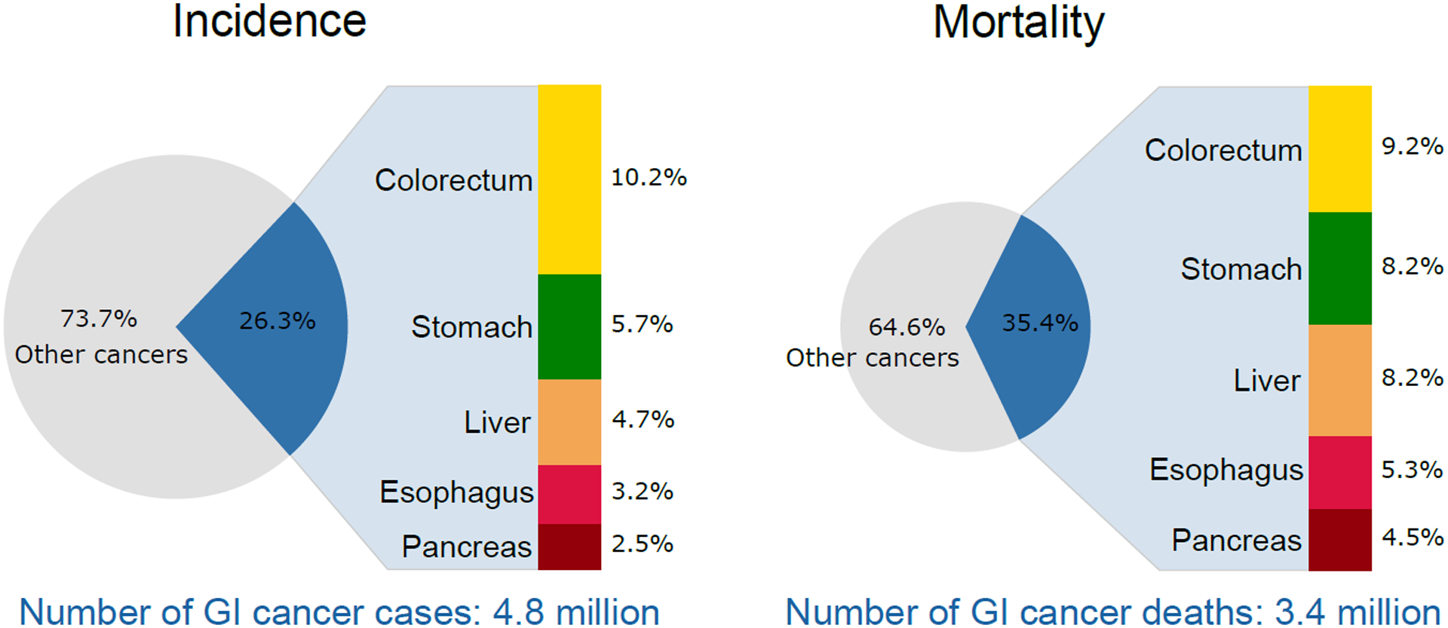
A. Melina; Global Burden of 5 Major Types of Gastrointestinal Cancer; 2018

Slide 6
Why Colorectal Cancer?
IMMUNOLOGY
Interdisciplinary focus
My long term interests
Cancer Biology
Microbiome
OMICS (scRNA-seq + Metagenomics + Metabolomics)

Slide 7
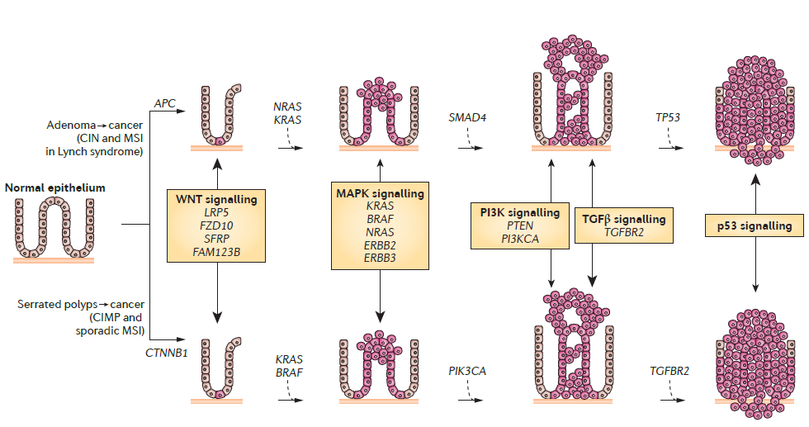
Causes of Colorectal Cancer
Genetic factors
DNA mismatch repair genes:
MSH2, MSH6
Environmetal factors
Lifestyle factors:
Smoking, alcohol consumption and obesity
Martina Rebesek; Gut microbiome and its role in colorectal cancer; BMC Cancer; 2021

Slide 8
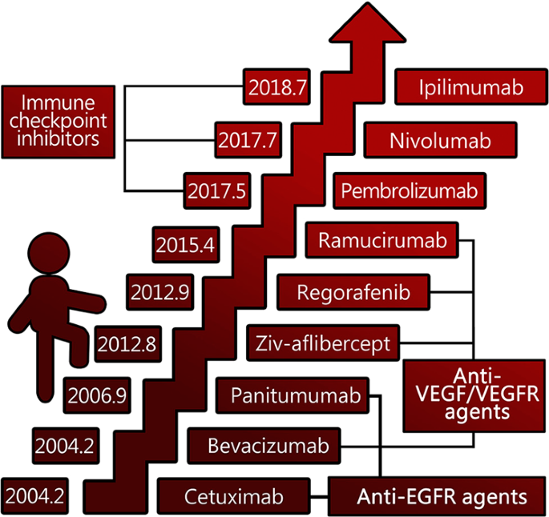
Only ~20 – 40% patient respond to Chemotherapy and Immunotherapy

Slide 9
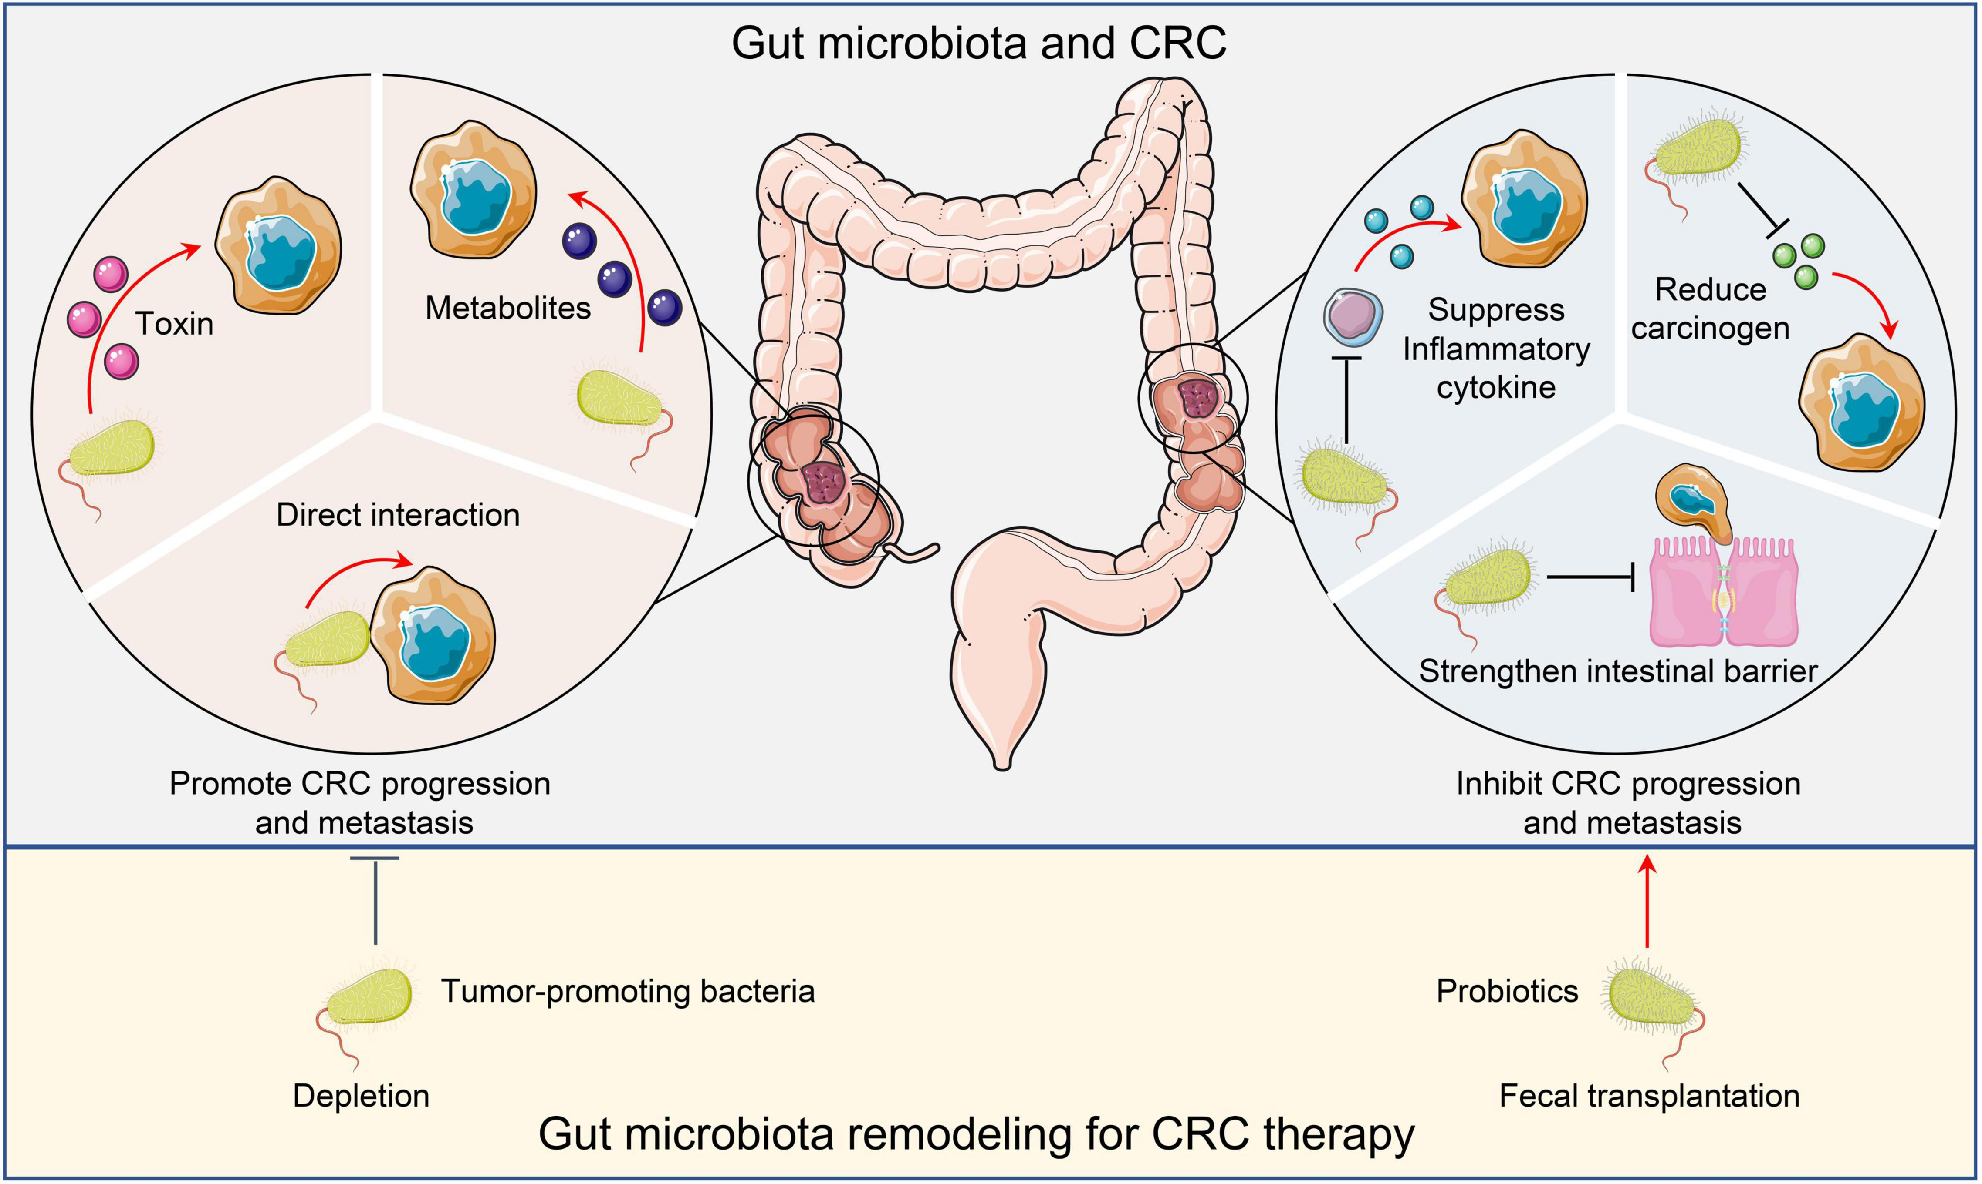
F.nucleatum
E.Coli
Parvimonas
F.prausnitzii
L.rhamnosus
B.lactis

Slide 10
Role of Microbiome in Cancer Microenvironment

Slide 11
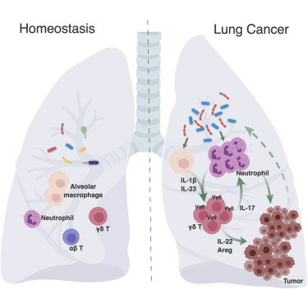
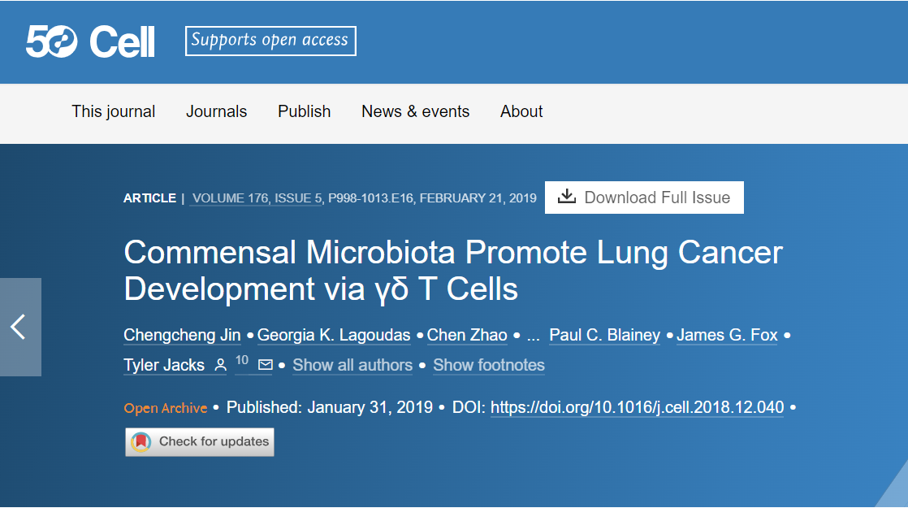
Tumor Microenvironment holds distinct microbiome
Airway Microbiota activates IL-17 γδ T-cells
Chronic inflammation
Lung adenocarcinoma

Slide 12
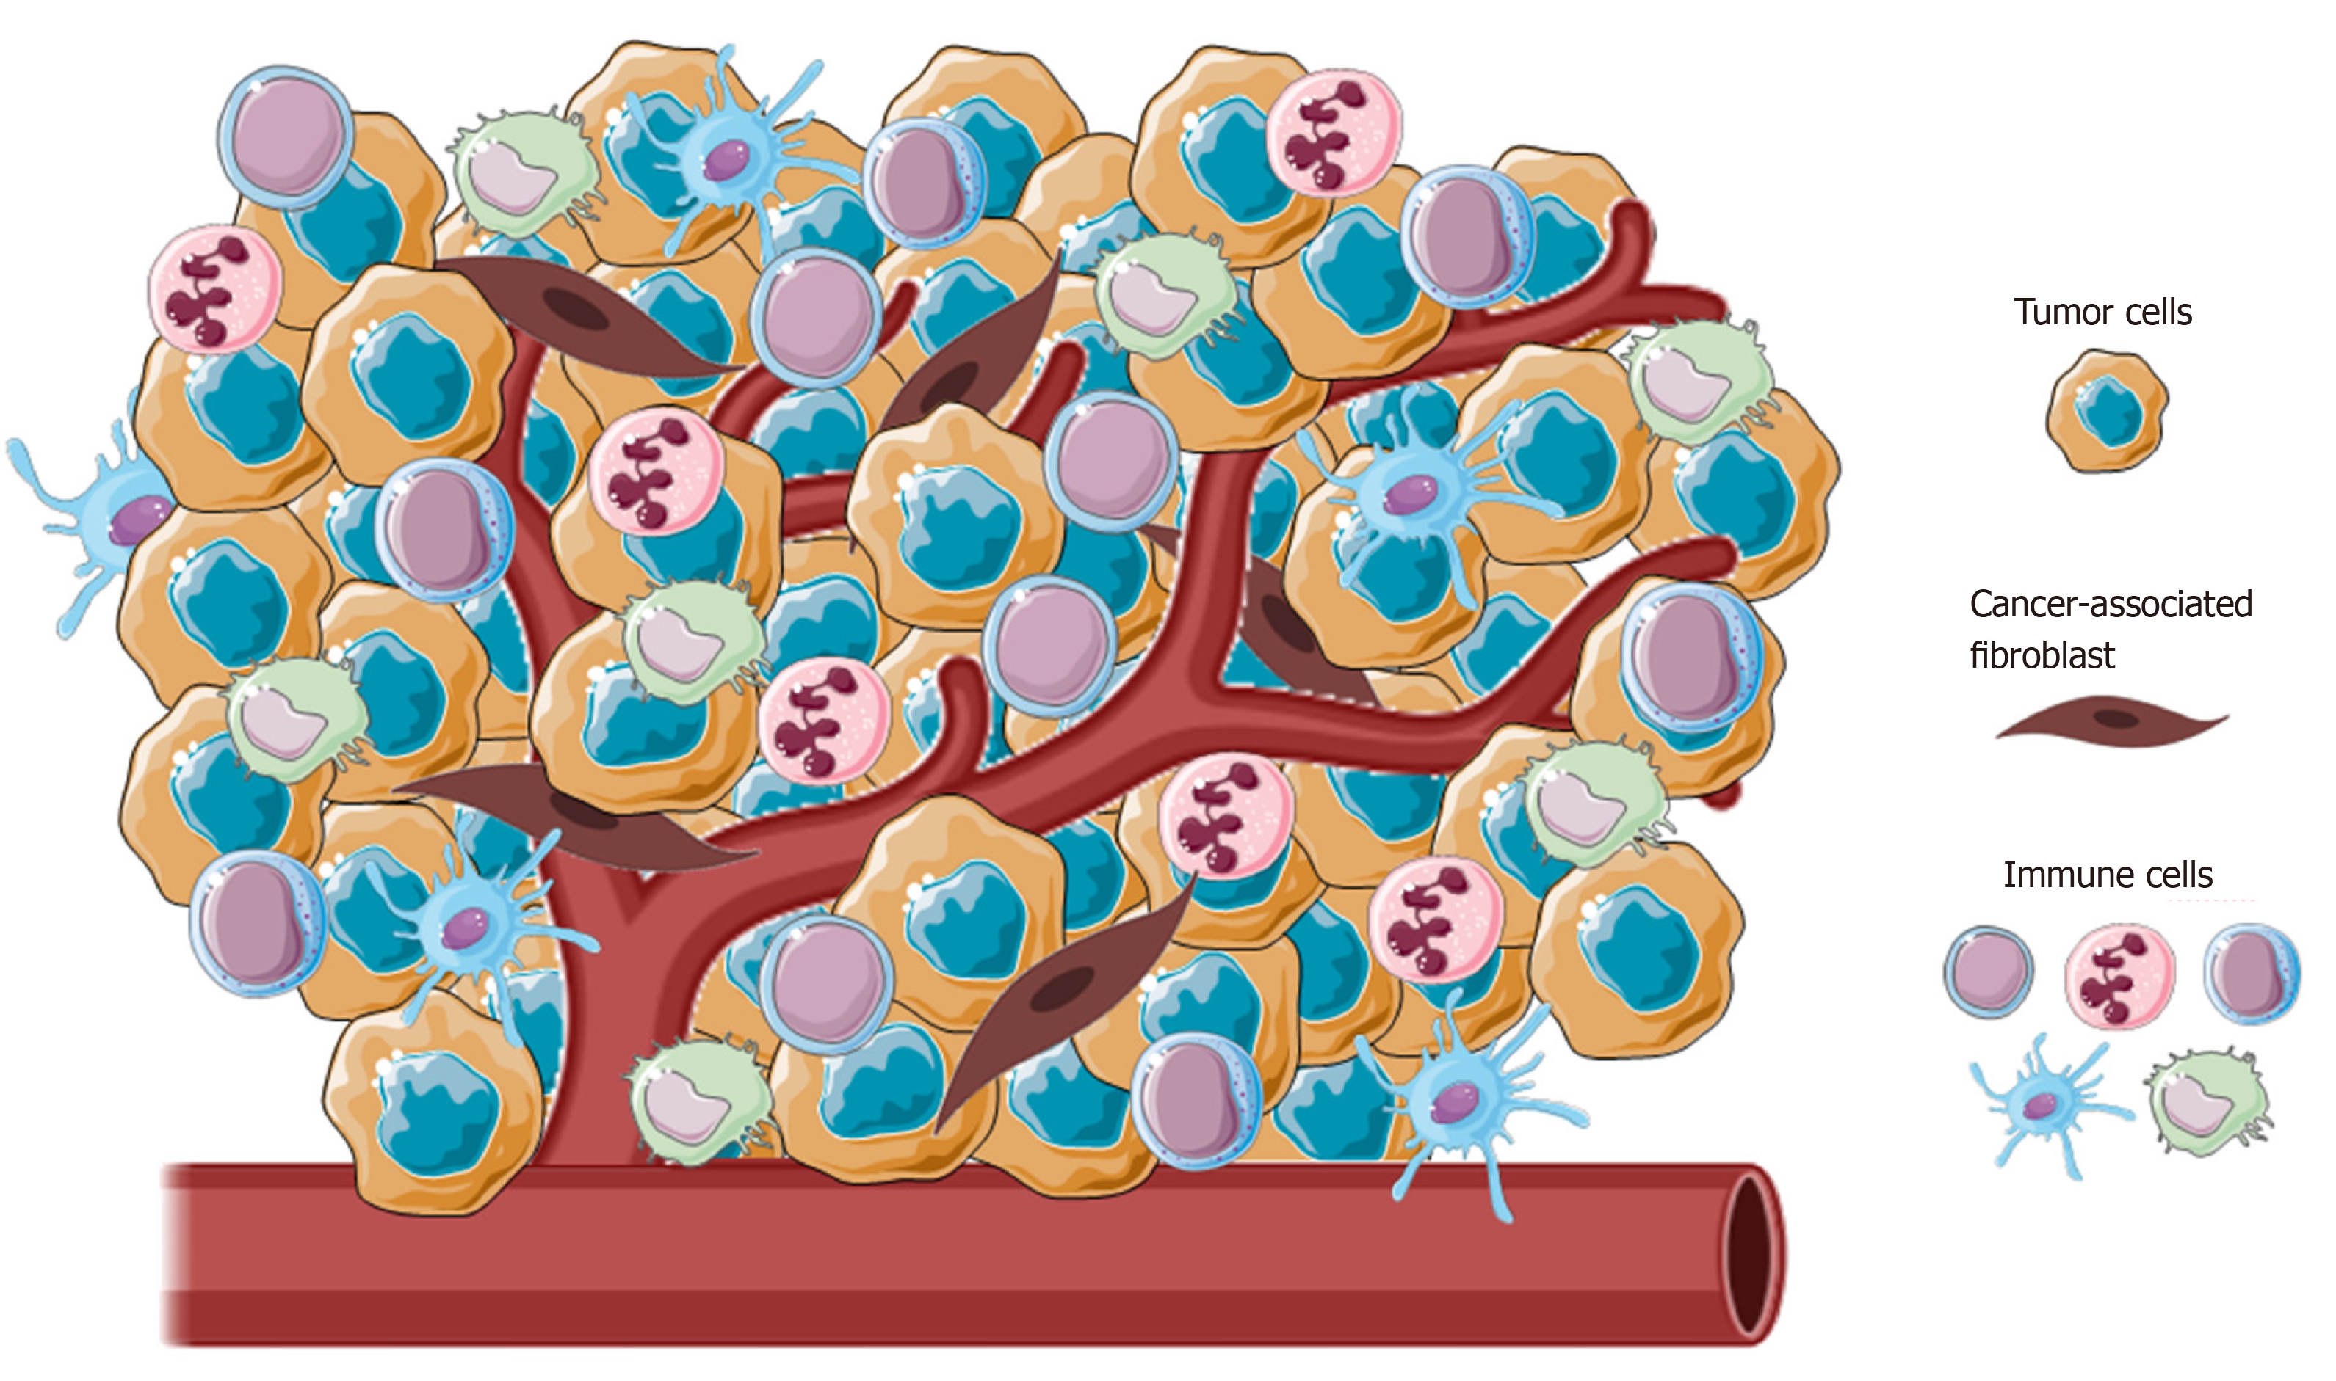
Association of microbiome promoting tumor growth
Tumor Microenvironment
Tumor Associated Macrophages (TAMs)
CD8⁺γδ⁺ T-cells

Slide 13
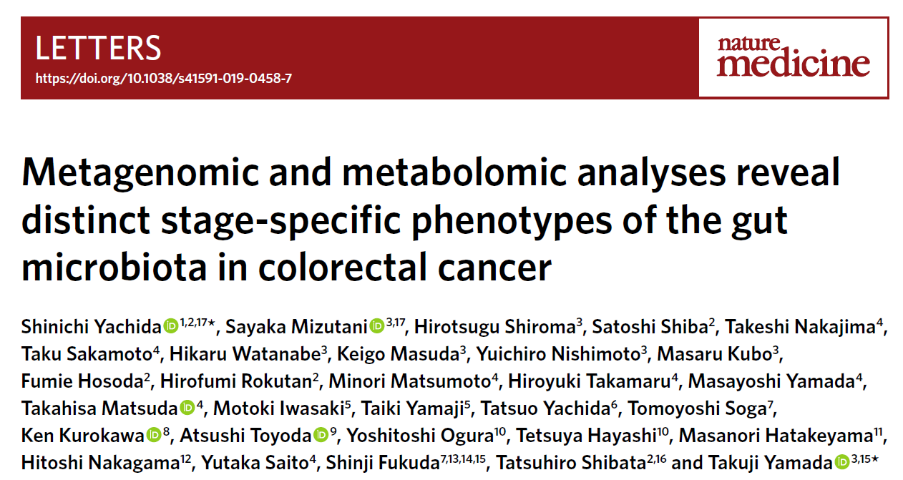

Slide 14
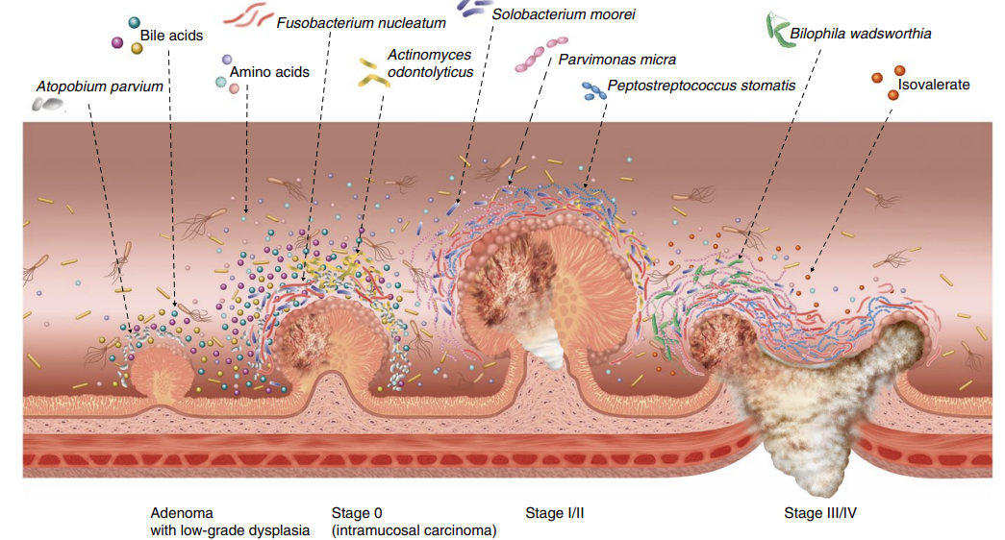
Stage Specific Biomarkers of Colorectal cancer
Important metabolic markers:
Phenylalanine & tyrosine biosynthesis
Important microbiome markers: F.nucleatum, A. parvium

Slide 15
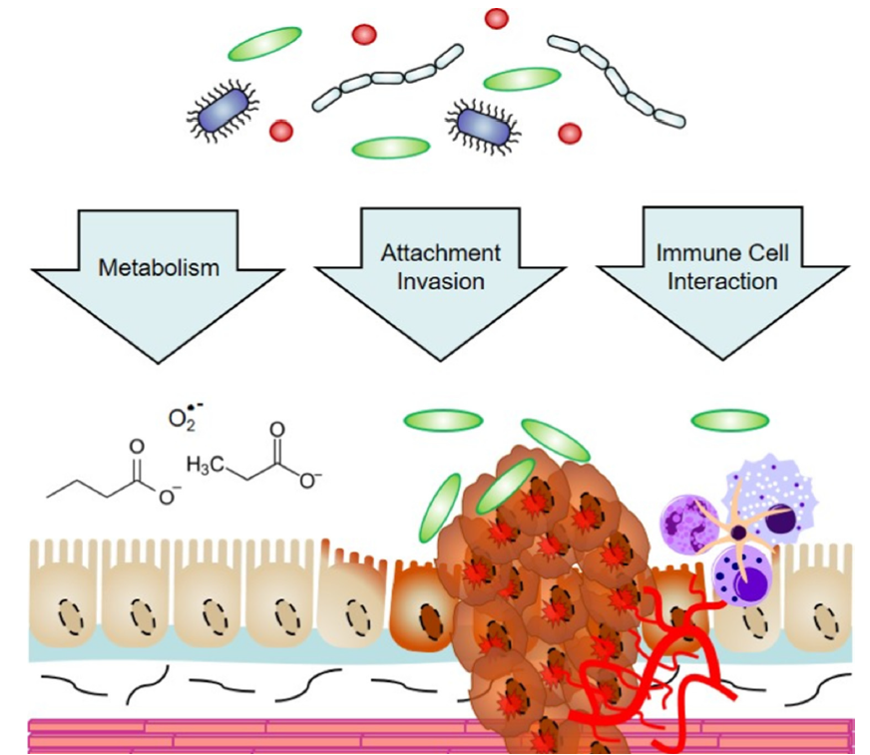
Multiple modes of action of microbiome?

Slide 16

What I am interested in?
Can Microbiome reverse the effects carcinogenesis in colorectal cancer?
C57BL/6J-Apc^{Min}/J
Analysis of Microbiome datasets
Identify the microbes significantly reduced in CRC patients
Screening of cultures in Mice Model
Metabolic markers & tissue specific transcriptional changes
Metabolomics & scRNA-Seq
Identify the cultures showing effects on CRC progression
Mechanisms

Slide 17
Applications
Microbiome Therapy for Colorectal Cancer
Microbiome-Host Immune Cross talk to identify immune cells associated with CRC progression
Microbiome use in CRC diagnosis and prognosis

Slide 18
THANK YOU

Slide 19


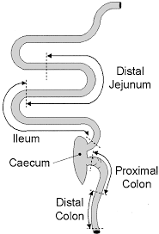
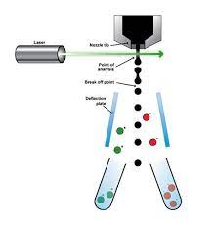

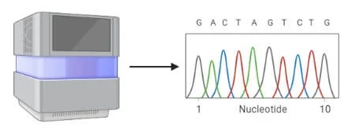
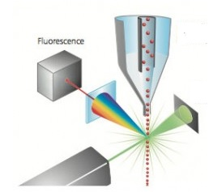



1.Develop mice model of CRC
2. Microbiome analysis
(Shotgun Metagenomics)
3. Single cell genomics
(scRNAseq)
Healthy
Healthy
CRC
Healthy
CRC
Induction of carcinogenesis
Colon
Colon
CRC
DNA extraction
scRNA-seq
FACS
+
scATAC-seq
1. Characterization of CRC stages
Library prep
Sequencing
Data Analysis
CRC
Cell type identification & characterization
FACS
Colony Counter
Healthy
Transcriptome analysis
Cell type annotation
Healthy
CRC
Data Analysis
CRC
Genus
Lactobacillus
Clostridium
Roseburia
Prevotella
Enterococcus
Streptococcus
Pseudomonas
Vellionella
Population structure Analysis
CRC clusters of cells
Healthy cluster of cells
Change in population of cells
Identification of new cell types
4. Identification of host-microbiome interactions
Microbiome in healthy
Cell A
Cell B
Ampicillin
Neomycin
Metronidazole
Microbiome in SIBO
Cellular effector molecules
Cells in Healthy
Cell B
Cells in SIBO
Secreted Microbial effectors
Receptor
Cell A
Cell B
Positive interactions
?
Negative interactions
ELISA, chemical assays, WB, labelling
Microbiome composition
effectors
Receptor

Slide 20
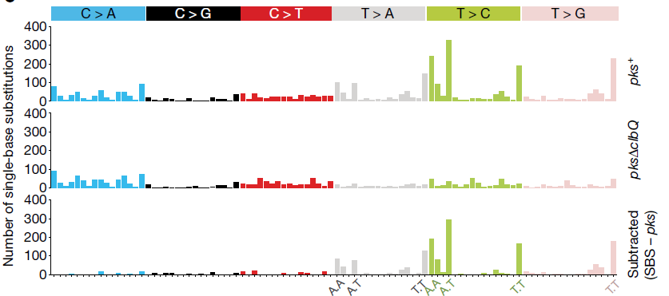

Slide 21
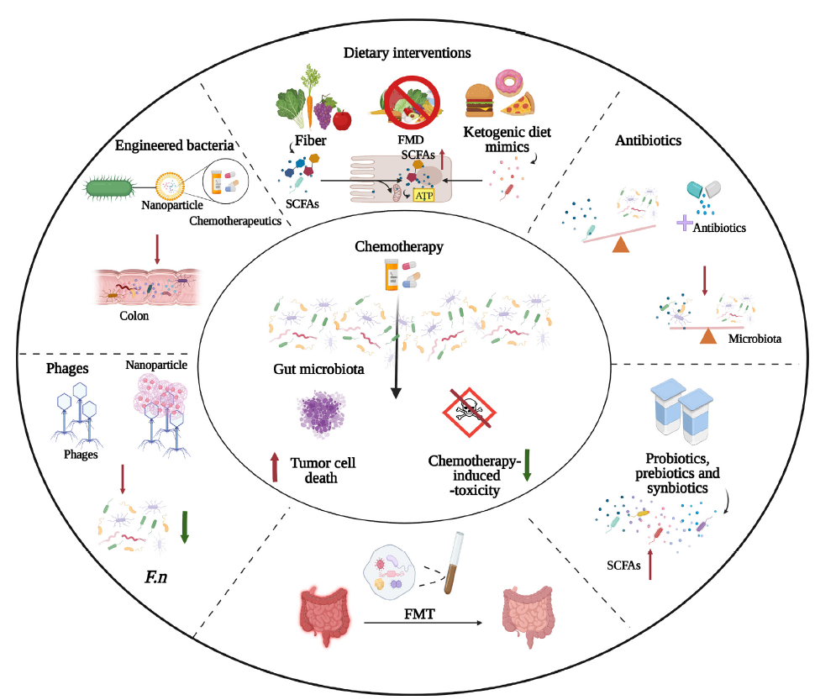
Microbiome plays prominent role in efficacy of the drugs
Shiyu Li et al; The role of gut microbiota and metabolites in colorectal cancer; J. Adv Res; 2023

Slide 22
Characterization of Colorectal cancer
Hypermutable microsatellite unstable
Hypermutable microsatellite stable
Microsatellite stable
CIMP cancers

Slide 23
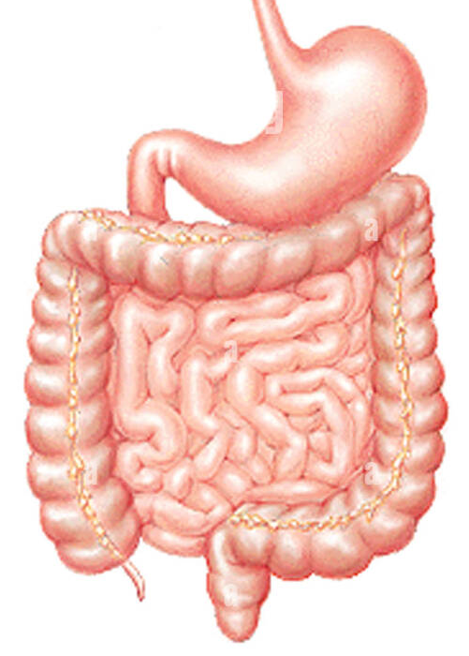
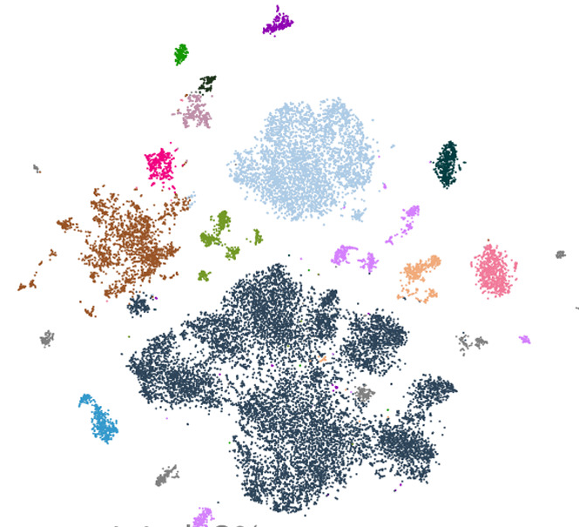
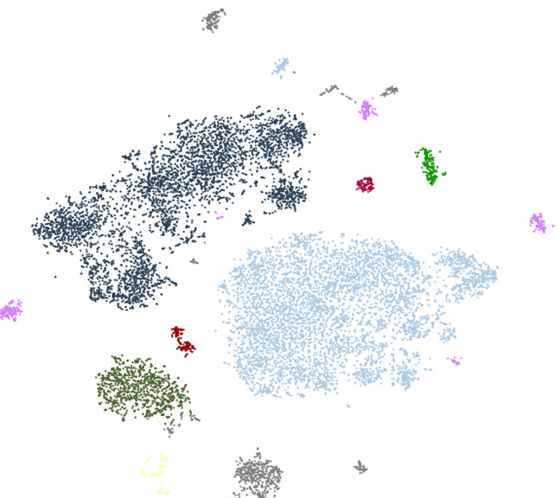
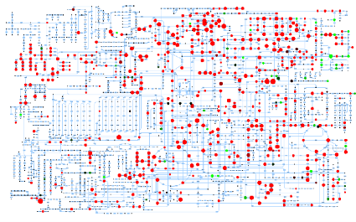


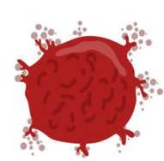
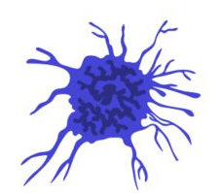

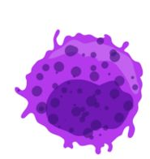
What I am interested in?
Colorectal Cancer patients
scRNA-Seq
Metagenomics
MicrobiomeChanges?
Gut-Microbiome crosstalk
Population structure
Cell types??
What defines the transcriptional state?
Metabolic exchange
Metabolomics
Gut Microbiome
Gut Microbial functions
Metabolite pool
Cell types
Human health

Slide 24
